Slide 1
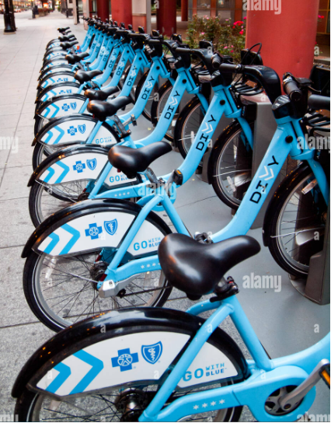
Prediction of Bike Sharing Demand
MOSHOOD Yussuf
Notes:
1

Slide 2
INTRODUCTION
Wednesday, December 13, 2022

Slide 3
Introduction
There are several sustainable transport development solutions in cities, such is the bike-sharing systems
For customers who want to travel without the hassle of owning or operating a vehicle, ride sharing services like Uber and Lyft offer convenient, cost-effective, and efficient transportation options.
However, as the number of cars grows, carpooling is no longer an effective solution, particularly in densely populated and busy areas like downtown cities.
Therefore, bike sharing is a great idea since it gives individuals additional means of short-distance transportation, allowing them to commute without being concerned about getting stuck in traffic and perhaps even take in some city views or exercise at the same time.
Wednesday, December 13, 2022
3
Notes:
3

Slide 4
DATASET
Wednesday, December 13, 2022
4

Slide 5
Dataset
The dataset I will be using contains 5000 observations and 12 variables.
The data was extracted from Kaggle, and it contains dataset spanning two years from 2011 to 2012
"count" will be used as response variable here, and all other as predictor the predictor variable.
The predictor variables are: datetime, season, holiday, workingday, weather, temp, atemp, humidity, windspeed, casual, registered, count
Wednesday, December 13, 2022
5
Notes:
5

Slide 6
DATA CLEANING
Wednesday, December 13, 2022
6

Slide 7
Data Cleaning
Using the Missing data function in R, we had no missing values.
The hourly date is in time stamp format. I converted it by creating new columns for “month”, “weekday”, “year and “hour” (hour of the day)
Also, because “weather”, “holiday” and “workingday” are categorical in nature i.e., Boolean expressions, I had to use the as factor expression to better express them.
The temp and atemp variable are identical so I deleted atemp and used only temp for my analysis.
After the cleaning process, the result of the data was reduced to 4446 observations and 12 variables and I constructed a data frame that summarizes the bike rental count base on the season, month, day, hour, is it a weekday, is it a holiday, weather type
Wednesday, December 13, 2022
7
Notes:
7

Slide 8
DATA PREPARATION
Wednesday, December 13, 2022
8

Slide 9
Data Preparation
I divided my dataset into training and validation sets before starting to create statistical models.
60% for training set and 40% for validation set
The validation set will be used to evaluate the model we develop with the training set, while the training set will be used to train statistical models and estimate coefficients. 40% of the total data is divided into a validation set, with the remaining 60% being divided into a training set that is consistently sampled without replacement.
The resulting training set and validation set each comprise 2667 and 1779 observations, respectively.
Wednesday, December 13, 2022
9
Notes:
9

Slide 10
DATA VISUALIZATION
Wednesday, December 13, 2022
10

Slide 11
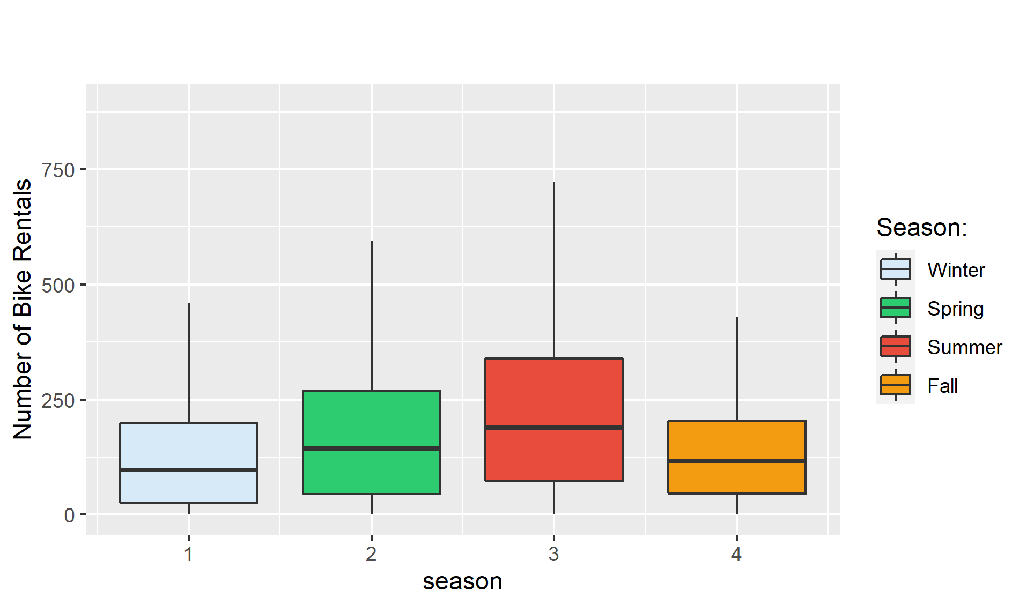
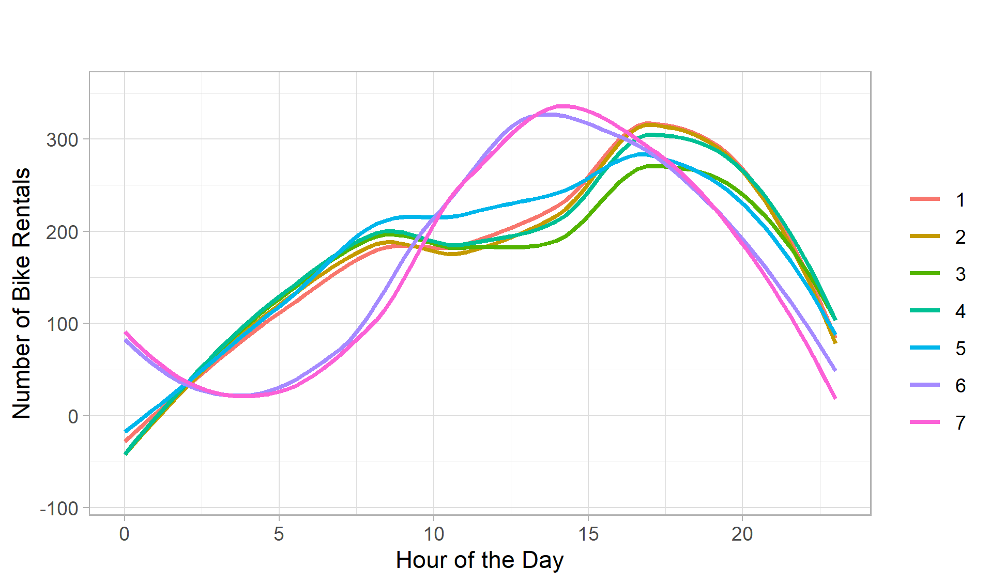
VISUALIZATIONS
Box PLOT
Line Plot

Slide 12
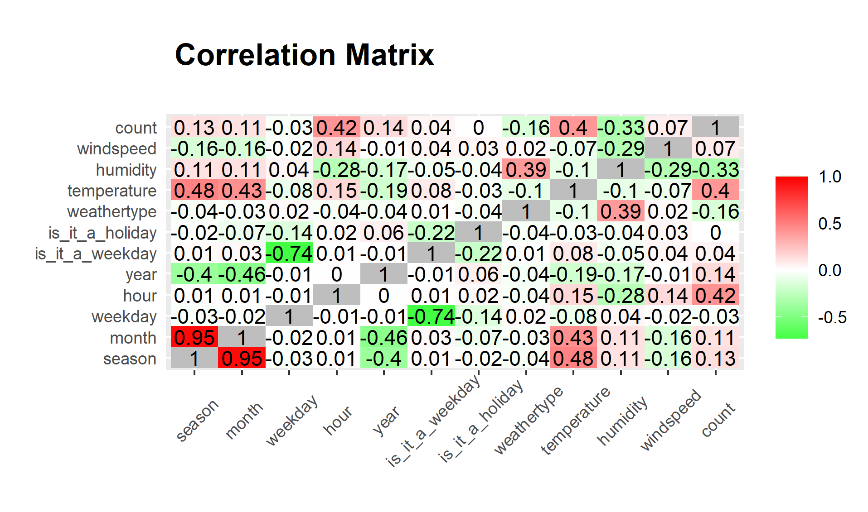
CORRELATION MATRIX

Slide 13
METHOD TYPES
Wednesday, December 13, 2022
11

Slide 14
Model Building Types
Simple Linear Regression
Logistic Regression
Neural Networks
Classification Tree
Random Forest
Bagging
Boosting
Wednesday, December 13, 2022
13
Notes:
13

Slide 15
LINEAR REGRESSION
Wednesday, December 13, 2022
14

Slide 16
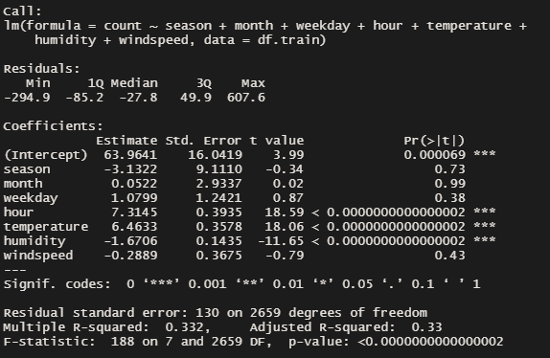
Linear Regression
I start out by building a simple linear model, pitting all the variables against the response. The simple linear regression model only achieved 0.33 adjusted R-squared, which indicates a weak fit. Four (4) of the regressors are significant at the 0.1% level, which is good.
Wednesday, December 13, 2022

Slide 17
Exhaustive, Forward and Backward Elimination Methods
I explored further by using the Forward, Backward and Exhaustive methods.
My overall model is the model with three predictors; “hour”, “humidity” and “temperature” because all four variable selection models suggested them, and the predictors are statistically significant at the 0.1% significant level
Wednesday, December 13, 2022
5
Notes:
5

Slide 18
LOGISITC REGRESSION
Wednesday, December 13, 2022
15

Slide 19
Logistic Regression
I start out by building a full logistic model, pitting all the variables against the response (count) and then a second model where pitted the response variable against the 4 regressors that where statistically significant from model 1
The AIC of model 1is 2728.9 and model 2 is 2845.2
The AUCROC value of model 1 is 0.818 and that of model 2 is 0.812
The sensitivity is 61.5% and the specificity is 84.4%
Wednesday, December 13, 2022
16
Notes:
16

Slide 20
Performance Metrics of the Logistic Regression
 | MODEL 1 | MODEL 2
Accuracy | 0.76 | 0.73
Precision | 0.62 | 0.59
Sensitivity | 0.72 | 0.69
F-1 Score | 0.67 | 0.64
Error | 0.24 | 0.265
Specificity | 0.78 | 0.76
AUC | 0.8184 | 0.8124
AIC | 2728.9 | 2845.2
Optimal Cut-off | 0.51 | 0.49
Wednesday, December 13, 2022
19
Notes:
19

Slide 21
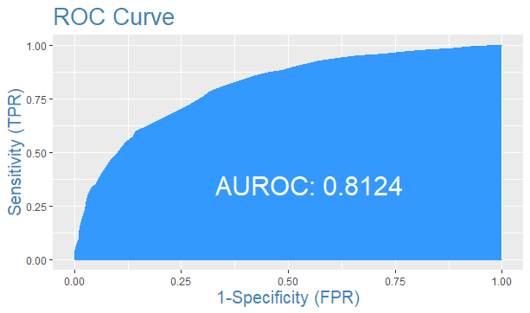
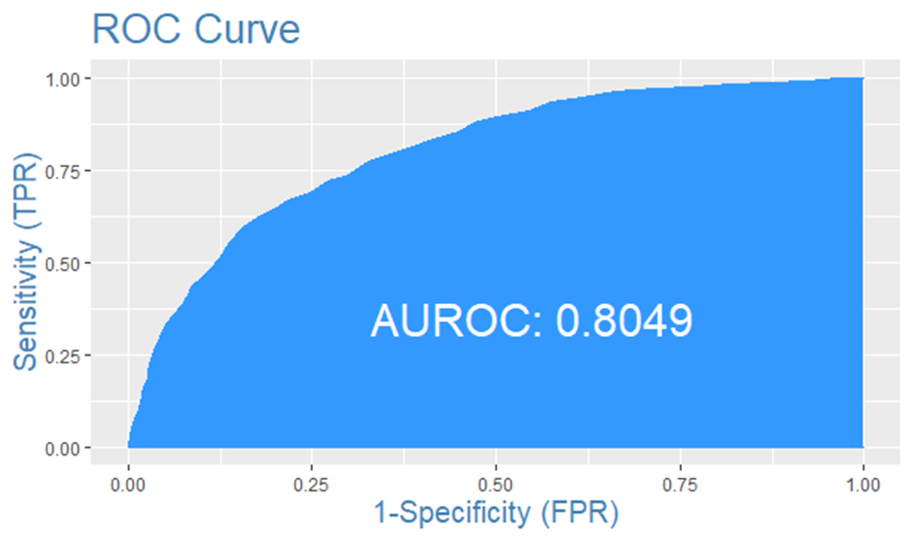
ROC Curve for Model 1 and Model 2
Wednesday, December 13, 2022

Slide 22
NEURAL NETWORK ANALYSIS
Wednesday, December 13, 2022
20

Slide 23
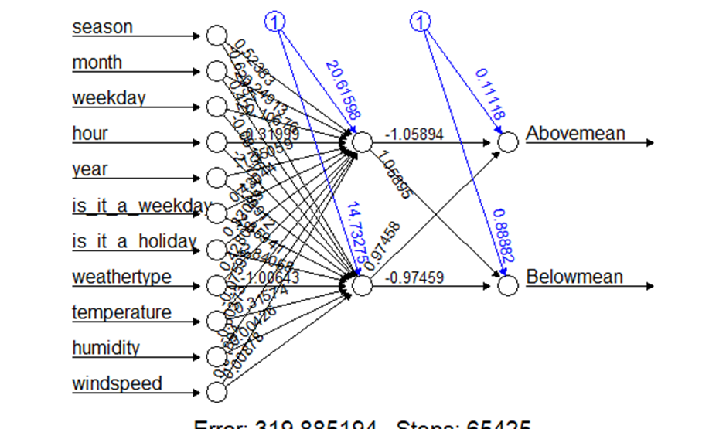
Neural Network
I start out by building a full Neural Network model just like in the logistic regression, pitting all the variables against the response (count). Then a second model based on the four regressors a used in logistic regression
For model 1,The number of true positive is 242, true negative is 1405, False negative is 164 and False positive is 856. For model 2, The number of true positive is 161, true negative is 935. False negative is 105 and False positive is 578
The AUCROC value for model 1 is 0.21 and for model 2 is 0.206
Monday, December 5, 2022
21
Notes:
21

Slide 24
Comparison of all both Models
 | MODEL 1 | MODEL 2
Accuracy | 0.62 | 0.62
Precision | 0.22 | 0.22
Sensitivity | 0.60 | 0.60
F-1 Score | 0.32 | 0.32
Error | 0.38 | 0.38
Specificity | 0.62 | 0.62
AUC | 0.21 | 0.206
Wednesday, December 13, 2022
23
Notes:
23

Slide 25
CLASSIFICATION TREE MODEL
Wednesday, December 13, 2022
24

Slide 26
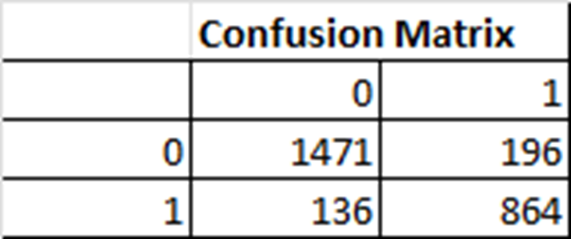
Classification Tree– Full Model
I start out by building a full model pitting all the variables against the response (count).
I made sure to specify the parameter method = “class” using the rpart() function in r
Wednesday, December 13, 2022
25
Notes:
25

Slide 27
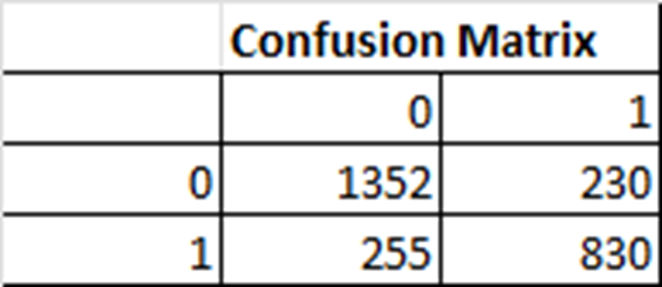
Classification Tree– Model 2
I start out by building a second model with the 4 regressors that where statistically significant in the logistic regression model.
They are: “hour”, “season”, “humidity” and “temperature”.
I tested my dataset using the predict() method to make a prediction using the train data.
Wednesday, December 13, 2022
26
Notes:
26

Slide 28
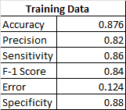
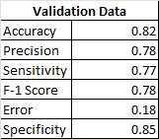
Performance Metric of Training and Validation Data
Wednesday, December 13, 2022
27
Notes:
27

Slide 29
RANDOMN FOREST MODEL
Wednesday, December 13, 2022
28

Slide 30
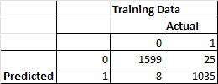
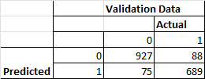
Performance Metrics of the Random Forest Model
Wednesday, December 13, 2022
29
Notes:
29

Slide 31
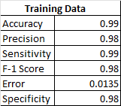
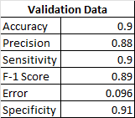
Performance Metrics of the Random Forest Model
Wednesday, December 13, 2022
30
Notes:
30

Slide 32
BOOSTING MODEL
Wednesday, December 13, 2022
31

Slide 33
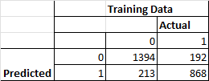
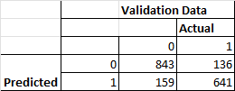
Performance Metrics of the Boosting Model
Wednesday, December 13, 2022
32
Notes:
32

Slide 34
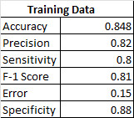
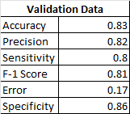
Performance Metrics of the Boosting Model
Wednesday, December 13, 2022
33
Notes:
33

Slide 35
BAGGING MODEL
Wednesday, December 13, 2022
34

Slide 36
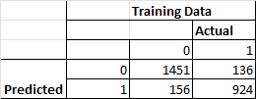
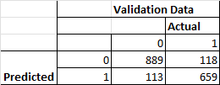
Performance Metrics of the Bagging Model
Wednesday, December 13, 2022
35
Notes:
35

Slide 37
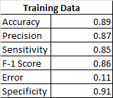
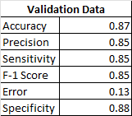
Performance Metrics of the Bagging Model
Wednesday, December 13, 2022
36
Notes:
36

Slide 38
Comparison of All methods
 | LOGISTIC REGRESSION | NEURAL NETWORK | CLASSIFICATION TREE | RANDOM FOREST | BOOSTING | BAGGING
Accuracy | 0.76 | 0.62 | 0.88 | 0.99 | 0.85 | 0.89
Precision | 0.62 | 0.22 | 0.82 | 0.98 | 0.82 | 0.87
Sensitivity | 0.72 | 0.6 | 0.86 | 0.99 | 0.8 | 0.85
F-1 Score | 0.67 | 0.32 | 0.84 | 0.98 | 0.81 | 0.86
Error | 0.24 | 0.38 | 0.12 | 0.0135 | 0.15 | 0.11
Specificity | 0.78 | 0.62 | 0.88 | 0.98 | 0.88 | 0.91
Wednesday, December 13, 2022
37
Notes:
37

Slide 39
CONCLUSION
Through exploratory analysis on the data about bike sharing rental counts, we discovered that hour of the day and temperature are the two most important factors that drives the demand of bike sharing rental.
The simple linear regression model achieved a small adjusted R-squared, which indicate a weak fit. This is ok since I only included this simple linear model to see how much variation in the response can numerical variables explain.
Using Classification tree model, Random forest model, Boosting and bagging models, I successfully predicted the bike sharing rental count with relatively high accuracy
The simple linear regression model only achieved 0.3389 adjusted R-squared, which indicate a weak fit. This is ok since I only included this simple linear model to see how much variation in the response can numerical variables explain.
The best model is the model with all predictors against the response variable count.
My overall best method is the Random Forest method. It had an accuracy of 98.7% which is extremely high. It had the lowest misclassification error of all the methods and models with a precision of 0.98.
Wednesday, December 13, 2022
3
Notes:
3

Slide 40
Thank You
Moshood Yussuf
Mf-Yussuf@wiu.edu
https://github.com/folomiskiyaski
Wednesday, December 13, 2022
39

